Slide 1


FULL STACK WEB DEVELOPMENT WITH DJANGO
Lecture 10

Slide 2

Today’s Agenda
Developing Our Django App
The for Tag
Variables Of for Tag
Example

Slide 3
The for Tag
The for tag
A for tag allows us to use to loop through a sequence. We can use for tag to iterate over the contents of list, tuples, dictionary etc.
{% for i in mylist %}
<p>The value of i is {{ i }}</p>
{% endfor %}
When the loop begins the first value from the mylist is assigned to the variable i. Then the template engine will render everything between {% for %} and {% endfor %}. This process keeps repeating until there are no more elements left to iterate in the mylist.

Slide 4
The for Tag
The for tag in reverse
To print a list in the reverse order add reversed keyword after the name of list as follows.
{% for i in mylist reversed %}
<p>The value of i is {{ i }}</p>
{% endfor %}

Slide 5
The for Tag
The for tag on dictionary
Similarly, we can access elements of a dictionary. Let’s say our context variable contains a dictionary named dict.
dict = { 'uno': 'one', 'dos': 'two', 'tres': 'three', 'cuatro': 'four' }
To access this dictionary inside the template use the following code:
{% for k, v in dict.items %}
<p>{{ k }} : {{ v }}</p>
{% endfor %}
Output:
uno : one
dos : two
tres : three
cuatro : four

Slide 6
The for empty Tag
The for empty tag
Suppose we have a context variable called post_list which is a list of post objects having a data member called title. Our job is to print a list of titles all blog posts.
Can you write the code ?
{% for post in post_list %}
<h2>{{ post.title }}</h2>
{% endfor %}
Can you figure out the problem with the above code ?

Slide 7
The for empty Tag
The for empty tag
The problem is that we haven’t checked whether any blog posts exists or not.
Can you provide a solution ?
{% if post_list %}
{% for post in post_list %}
<h2>{{ post.title }}</h2>
{% endfor %}
{% else %}
No post published yet.
{% endif %}

Slide 8
The for empty Tag
Alternate Solution :The for empty tag
This kind of pattern is so common that Django provides a nice shortcut to it.
The for tag can take an additional {% empty %} tag. This tag let you define what to output in the case if list is empty.
{% for post in post_list %}
<h2>{{ post.title }}</h2>
{% empty %}
No post published yet.
{% endfor %}

Slide 9
The for Tag Variables
The for tag variable
The for tag provides a special variable called forloop.
The forloop variable has few attributes that we can use to track the progress of the loop..

Slide 10
The for Tag Variables
The forloop.counter:– It returns a number indicating the current iteration of the loop. It starts with 1.
Suppose our context contains a list named list defined as follows:
list = [11,12,13]
{% for i in list %}
<p>{{ forloop.counter }} Iteration - {{ i }}</p>
{% endfor %}
Output:
1 Iteration - 11
2 Iteration - 12
3 Iteration - 13

Slide 11
The for Tag Variables
The forloop.counter0 – Works same as forloop.counter but begins with 0 instead of 1.
{% for i in list %}
<p>{{ forloop.counter0 }} Iteration - {{ i }}</p>
{% endfor %}
Output:
0 Iteration - 11
1 Iteration - 12
2 Iteration - 13

Slide 12
The for Tag Variables
The forloop.revcounter – It returns the number of iteration from the end of the loop.
{% for i in list %}
<p>{{ forloop.revcounter }} Iteration - {{ i }}</p>
{% endfor %}
Output:
3 Iteration - 11
2 Iteration - 12
1 Iteration - 13

Slide 13
The for Tag Variables
The forloop.revcounter0 – Same as forloop.revcounter but it is 0 indexed.
{% for i in list %}
<p>{{ forloop.revcounter0 }} Iteration - {{ i }}</p>
{% endfor %}
Output:
2 Iteration - 11
1 Iteration - 12
0 Iteration - 13

Slide 14
The for Tag Variables
The forloop.first – It returns a Boolean True if the current iteration is the first iteration. Otherwise False.
{% for i in list %}
<p>{{ forloop.first }} Iteration - {{ i }}</p>
{% endfor %}
Output:
True Iteration - 11
False Iteration - 12
False Iteration - 13

Slide 15
The for Tag Variables
The forloop.lastst – It returns a Boolean True if the current iteration is the last iteration. Otherwise False.
{% for i in list %}
<p>{{ forloop.last }} Iteration - {{ i }}</p>
{% endfor %}
Output:
False Iteration - 11
False Iteration - 12
True Iteration - 13

Slide 16

Exercise
Suppose you have following data extracted from emp table:
Write a Django App using templates which displays this complete data as shown on the next slide
EmpNo | Ename | Salary | Hiredate
101 | Amit | 50000.0 | August 27,2018
102 | Deepak | 45000.0 | November 29,2018

Slide 17
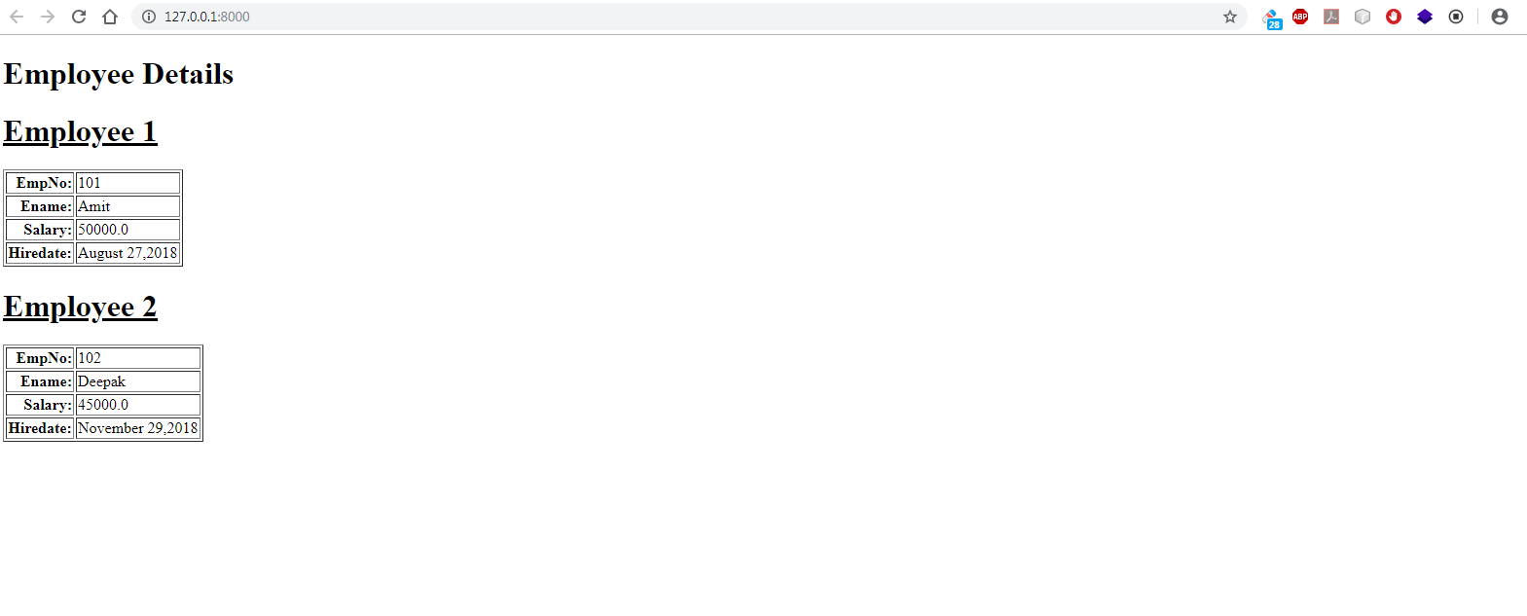
Exercise

Slide 18
Solution
As usual we will first have to setup VS Code and create the project and app as follows:
Create a folder called myfifthvsdjangoproject inside djangoexamples
Open VS Code and open the folder myfifthvsdjangoproject in it
Open the command palette and new terminal to activate django virtual environment called vsdjango
Now create a project called templateproject3 using the usual command django-admin startproject templateproject3
Then create the app by using the command django-admin startapp templateapp3
Create a folder called templates in the root folder templateproject3 and within templates create a folder called templateapp3

Slide 19
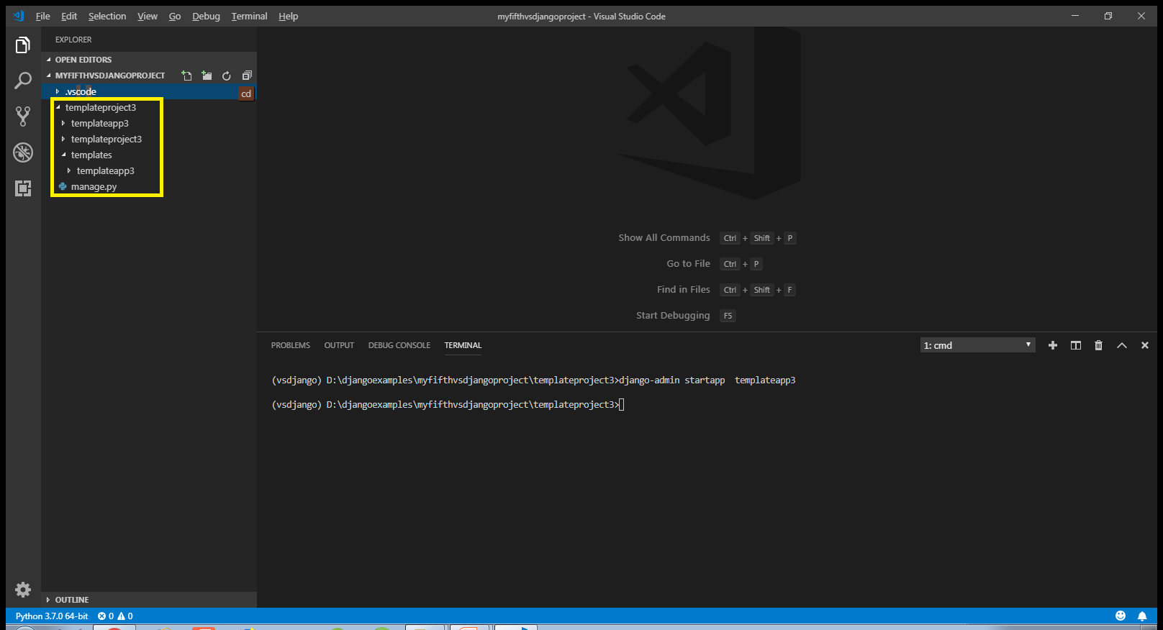
Solution

Slide 20
Solution
After doing all the initial setup in VS Code , the next task is to update the settings.py file by making 2 entries:
Entry for the app in the INSTALLED APPS list
Entry for the template directory in DIR key of TEMPLATES

Slide 21
Solution
Open the settings.py file in the templateproject3 app of our templateproject3 folder and make the entry shown in green color in the INSTALLED_APPS list
Code:
INSTALLED_APPS = [
'django.contrib.admin',
'django.contrib.auth',
'django.contrib.contenttypes',
'django.contrib.sessions',
'django.contrib.messages',
'django.contrib.staticfiles',
‘templateapp3',
]

Slide 22
Solution
In the settings.py of templateproject3 app locate the TEMPLATES list and modify it’s DIR key as shown below:
TEMPLATES = [
{ ...
'DIRS': [os.path.join(BASE_DIR, 'templates')],
... },
]

Slide 23
Solution
Now we have the template in place, we need to update our views.py.
In our views.py file , we must do the following:
Create a List called emp_recs .
This list should contain 2 dictionary objects
Each dictionary object will have 4 key-value pairs , where key will be the DB column name and value will be it’s corresponding value.
Then we should define a function called homePageView() , create a dictionary object called context and place this list object inside our context dictionary with the key name set to records
Then we should call the render() function passing it 3 arguments:
Request object
Template file path assuming that the html file name is showempdetails.html
Context dictionary

Slide 24
Solution
from django.shortcuts import render
emp_recs=[
{
'empno':101,
'ename':'Amit',
'salary':50000.0,
'hiredate':'August 27,2018'
},
{
'empno':102,
'ename':'Deepak',
'salary':45000.0,
'hiredate':'November 29,2018'
},
]

Slide 25
Solution
def homePageView(request):
context={'records':emp_recs}
return render(request,"templateapp3/showempdetails.html",context)

Slide 26
Solution
Once we’ve done the view and template folder structure then we can create an html file called showemp.html inside of the templates/templateapp3 directory.
This file should display the data from the list , passed by the views.py file , called records using template tags

Slide 27
Solution
#showempdetials.html
<!DOCTYPE html>
<html lang="en">
<head>
<meta charset="UTF-8">
<meta name="viewport" content="width=device-width, initial-scale=1.0">
<meta http-equiv="X-UA-Compatible" content="ie=edge">
<title>Template Tags Demo</title>
</head>
<body>
<h1>Employee Details </h1>
{% for e in records%}
<h1><u>Employee {{forloop.counter}}</u></h1>
<table border='1'>
<tr><th align='right'>EmpNo:</th><td>{{e.empno}}</td></tr>
<tr><th align='right'>Ename:</th><td>{{e.ename}}</td></tr>
<tr><th align='right'>Salary:</th><td>{{e.salary}}</td></tr>
<tr><th>Hiredate:</th><td>{{e.hiredate}}</td></tr>
</table>
{%endfor%}
</body>
</html>

Slide 28
Solution
After creating and updating the views.py we need to tell Django this is the view we want displayed when someone navigates to the site root (home page).
As usual we do this by configuring our URLs at 2 places:
Inside the templateapp3 directory’s urls.py file
Inside the site’s main urls.py

Slide 29
Solution
In the VS Code create a new file called urls.py in the templateapp3 folder and write the following code in it.
Code (templateapp3/urls.py):
from django.urls import path
from . import views
urlpatterns = [
path('', views.homePageView, name ='index'),
]

Slide 30
Solution
As we know whenever a request arrives it first hits the main urls.py file , that is , the file urls.py in the directory templateproject3.
So we must configure this file also so that it simply redirects the request to our templateapp3’s urls.py file whenever a request arrives

Slide 31
Solution
In the VS Code open the file called urls.py in the templateproject3 folder and update the code in it as shown below in green.
Code (templateproject3/urls.py):
from django.contrib import admin
from django.urls import path,include
urlpatterns = [
path('admin/', admin.site.urls),
path('',include('templateapp3.urls')),
]

Slide 32
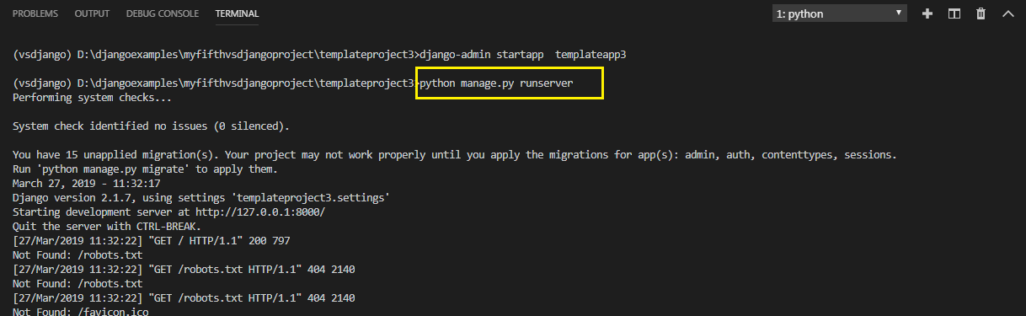
Solution
To run our new templateapp2 , go to the folder templateproject3 by using cd command and type the runserver command in VS Code terminal
cd templateproject3
python manage.py runserver.
The server runs on the default port 8000, and we’ll see output like the following output in the terminal window:

Slide 33
Solution
Ctrl+click the http://127.0.0.1:8000/ URL in the terminal output window to open default browser to that address. Now we should see the employee data as a template based home page

Slide 34
Exercise
Your previous template page is showing the title “Template Tags Demo” . Modify the app in such a way that if a title variable is passed from the view , then the page shows it as the title otherwise it should display the title “Template Tags Demo”

Slide 35
Solution
Everything will remain same except 2 changes
We will have to update the view so that it now sends a key called title in the context with the value “Staff Details” .
In the HTML file we will have to use {{% if %}} tag to check whether the key title exists or not . If it exists then we should display it’s value in the title tag otherwise we should display the message “Template Tags Demo”

Slide 36
Solution (views.py)
....
….
def homePageView(request):
context={'records':emp_recs,'title':'Staff Details'}
return render(request,"templateapp3/showempdetails.html",context)

Slide 37
Solution(showempdetails.html)
<!DOCTYPE html>
<html lang="en">
<head>
<meta charset="UTF-8">
<meta name="viewport" content="width=device-width, initial-scale=1.0">
<meta http-equiv="X-UA-Compatible" content="ie=edge">
{%if title%}
<title>{{title}}</title>
{%else%}
<title>Template Tags Demo</title>
{%endif%}
</head>
<body>
....
….
</body>
</html>

Slide 38
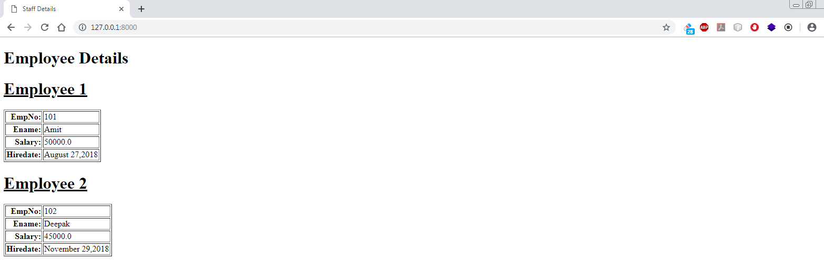
Solution
Ctrl+click the http://127.0.0.1:8000/ URL in the terminal output window to open default browser to that address. Now we should see the title as Staff Details

